Slide 1
Chapter 16
Series-Parallel Circuits

Slide 2
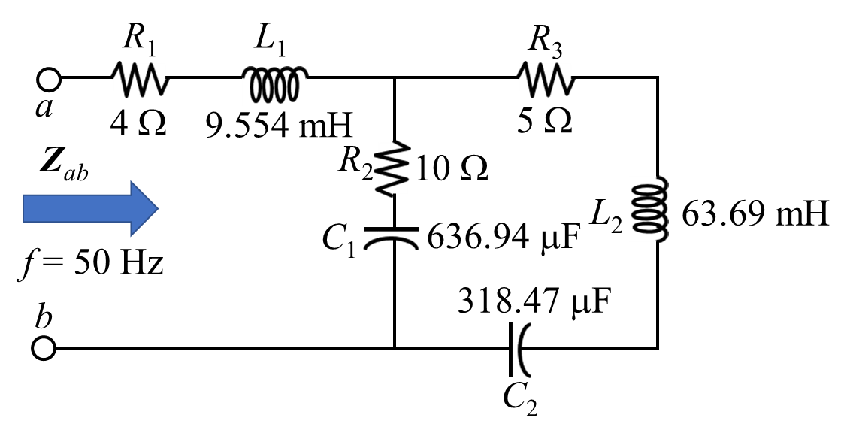
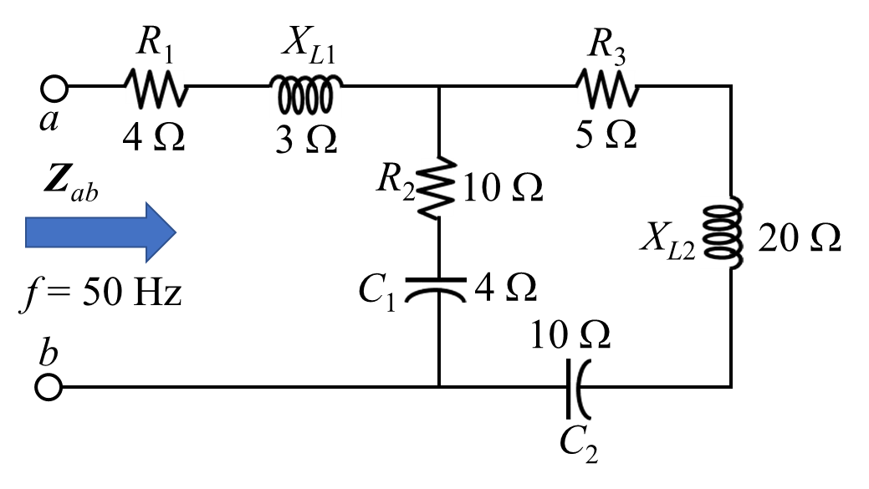
EXAMPLE: Calculate the impedance at terminals a and b for the following electrical network.
c
(2) Identify and mark the nodes/junctions.
Solution:
(1) Calculate all reactance if needed.
There are two branches are connected between terminals c and b.
Write the impedances in different branches.
Z_{ac} = 4 + j3 Ω
Z_{cb1} = 10 − j5 Ω
Z_{cb2} = 5 + j20 − j10 = 5 + j10 Ω
Redraw the circuit showing the impedance.
2

Slide 3
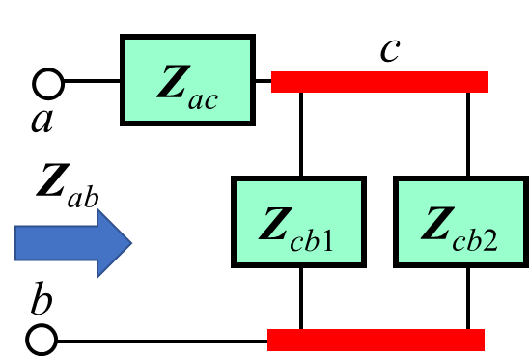
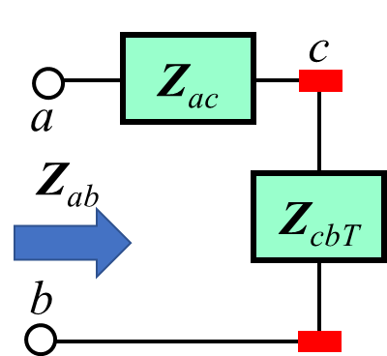
Z_{ac} = 4 + j3 Ω
Z_{cb1} = 10 − j5 Ω
Z_{cb2} = 5 + j20 − j10 = 5 + j10 Ω
3

Slide 4
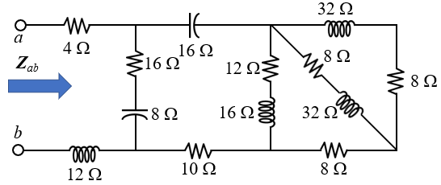
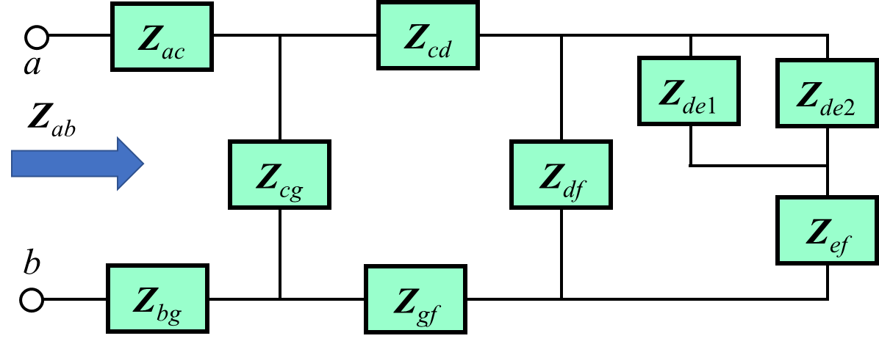
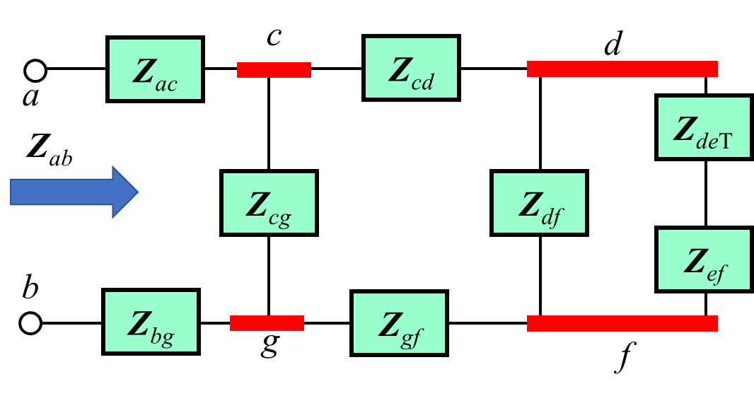
EXAMPLE: Calculate the impedance at terminals a and b for the following electrical network.
c
d
d
c
e
g
f
e
g
f
Solution:
(1) Identify and mark the nodes/junctions.
There are two branches are connected between nodes d and e.
Write the impedances in different branches.
Z_{de1} = 8 + j32 Ω; Z_{de2} = 8 + j32 Ω;
Z_{ef} = 8 Ω; Z_{df} = 12 + j16 Ω;
Z_{gf} = 10 Ω; Z_{cd} = − j16 Ω;
Z_{cg} = 16 − j8 Ω; Z_{ac} = 4 Ω; Z_{bg} = j12 Ω;
Redraw the circuit showing the impedance.
4

Slide 5
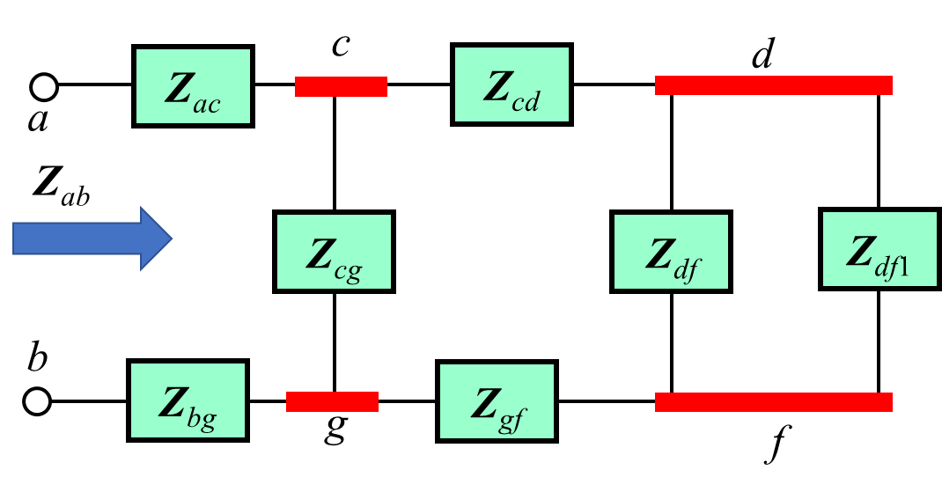
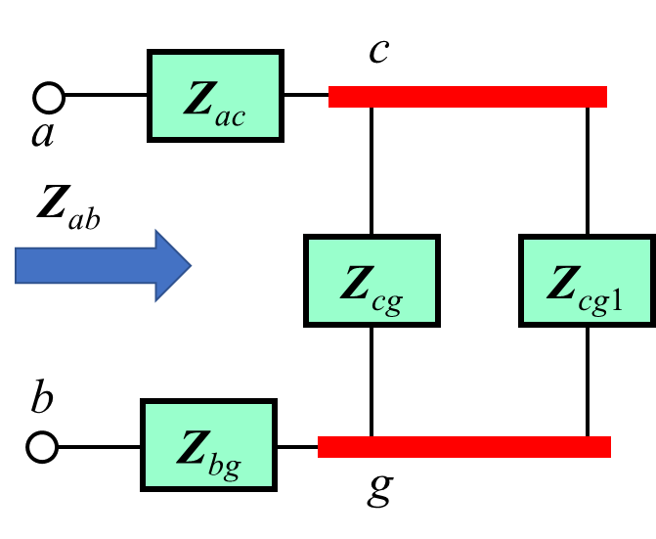
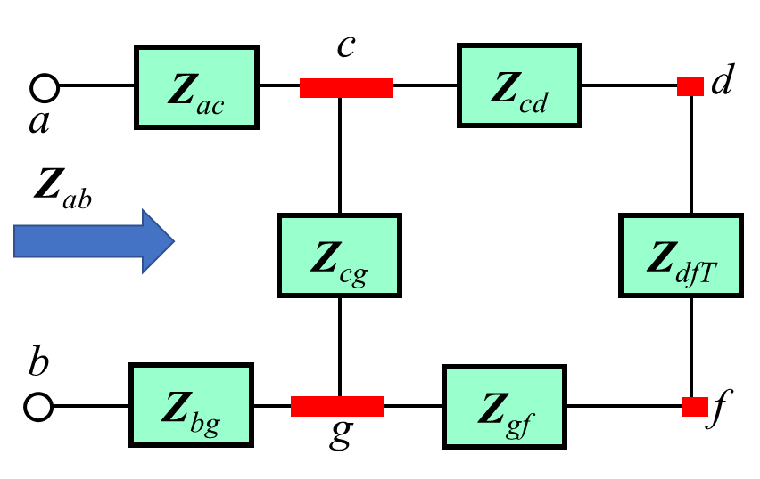
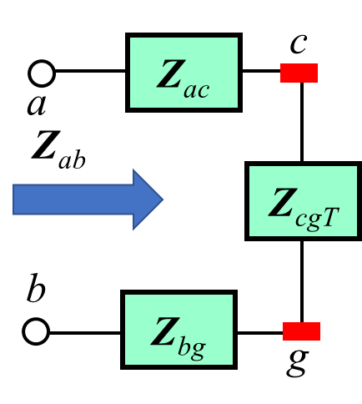
Z_{de1} = 8 + j32 Ω
Z_{de2} = 8 + j32 Ω
Z_{ef} = 8 Ω
Z_{df} = 12 + j16 Ω
Z_{gf} = 10 Ω
Z_{cd} = − j16 Ω
Z_{cg} = 16 − j8 Ω
Z_{ac} = 4 Ω
Z_{bg} = j12 Ω
5

Slide 6
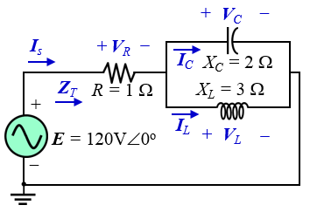
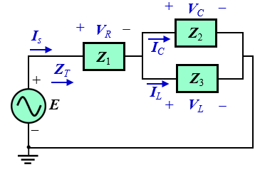
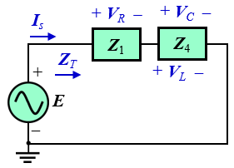
EXAMPLE 16.1: For the network in Fig. 16.1:
(a) Calculate Z_{T}. (b) Determine I_{s}.
(c) Calculate V_{R}, V_{C} and V_{L}. (d) Find the I_{C} and I_{L}.
(e) Compute the power delivered.
(e) Find power factor (F_{p}) of the network.
Solution:
Let, $Z_{1}$ = 1 Ω = 1Ω∠0º; $Z_{2}$= −j2 Ω = 2Ω∠−90º; $Z_{3}$ = j3 Ω = 3Ω∠90º;
Fig. 16.1(a) shows the redrawing circuit of Fig. 16.1.
Fig. 16.1: Example 16.1.
$Z_{4}= \frac{Z_{2}Z_{3}}{Z_{2}+Z_{3}}=\frac{(−j2)(j3)}{\left(−j2\right)+(j3)}$ = −j6 Ω = 6Ω∠−90º
Fig. 16.1(b) shows the redrawing circuit of Fig. 16.1(a).
$$Z_{T}=Z_{1}+Z_{4}=1−j6 $$
$=6.08−80.54°$
$${\left(b\right) I}_{s}= \frac{E}{Z_{T}}=\frac{120V∠0°}{6.08Ω∠−80.54°}$$
$=19.74A80.54°$
Fig. 16.1(b)
Fig. 16.1(a)
6

Slide 7
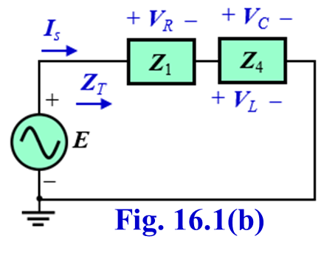
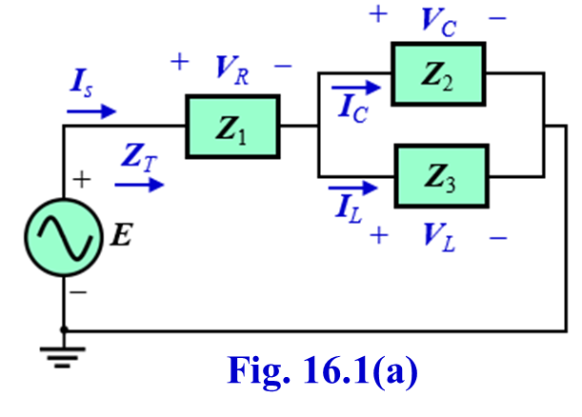
(c) Referring to Fig. 16.1(b), we have.
$$V_{R}=I_{s}Z_{1}=\left(19.74A∠80.54°\right)\left(1Ω∠0°\right)=19.74V∠80.54°$$
$$V_{C}=V_{L}=I_{s}Z_{4}=\left(19.74A∠80.54°\right)\left(6Ω∠−90°\right)=118.44V∠−9.46°$$
(d) Referring to Fig. 16.1(b), we have.
$$I_{C}= \frac{V_{C}}{Z_{C}}=\frac{118.44V∠−9.46°}{2Ω∠−90°}=59.22A∠80.54°$$
$$I_{L}= \frac{V_{L}}{Z_{L}}=\frac{118.44V∠−9.46°}{3Ω∠90°}=39.48A∠−99.46°$$
$${\left(e\right) P}_{del}=I_{s}^{2}R={(19.74)}^{2} \left(1Ω\right)=389.67 W$$
$${\left(f\right) pf=F}_{p}=cosθ=\cos\left(80.54°\right)=0.164 Leading$$
7

Slide 8
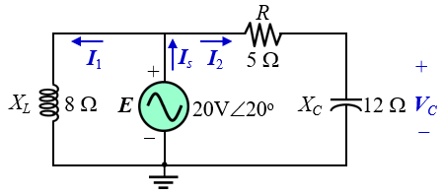
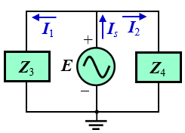
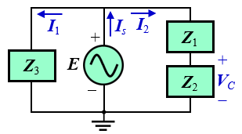
EXAMPLE 16.3: For the network in Fig. 16.5:
(a) Calculate the total impedance Z_{T} and the current I_{s}.
(b) Calculate the voltage V_{C} using the voltage divider rule.
(c) Calculate the currents I₁ and I₂ using the current divider rule.
(d) Calculate the power consumption by R, the reactive power consumption by L and the reactive power supplied by C.
(e) Calculate the apparent power, the power and the reactive power delivered by source.
Fig. 16.5: Example 16.3.
Solution:
Let, $Z_{1}$ = 5 Ω = 5Ω∠0º;
$Z_{2}$= −j12 Ω=12Ω∠−90º;
$Z_{3}$ = j8 Ω = 8Ω∠90º;
$Z_{4}$ = $Z_{1}$+ $Z_{2}$= 5 − j12 Ω = 13Ω∠−67.38º
Fig. 16.5(b) shows the redrawing circuit of Fig. 16.5(a).
Fig. 16.5(a) shows the redrawing circuit of Fig. 16.5.
$Z_{T}= \frac{Z_{3}Z_{4}}{Z_{3}+Z_{4}}=\frac{(j8)(5−j3)}{\left(j8\right)+(5−j3)}$
= 7.8 + j14.24 Ω
= 16.24Ω∠61.29º
$$I_{s}= \frac{E}{Z_{T}}=\frac{20V∠20°}{16.24Ω∠61.29°}$$
$=1.23A40.29°$
Fig. 16.5(b)
Fig. 16.5(a)
8

Slide 9
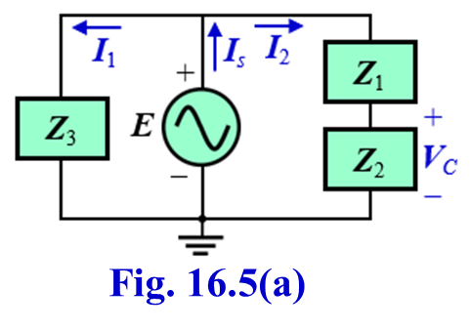
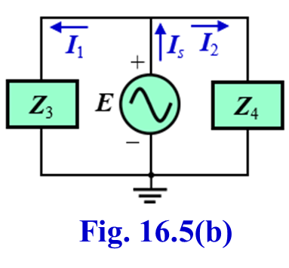
(b) Calculate the voltage V_{C} using the voltage divider rule.
(d) Calculate the power consumption by R, the reactive power consumption by L and the reactive power supplied by C.
Referring to Fig. 16.5(a), we have.
$$V_{C}= \frac{Z_{2}E}{Z_{1}+Z_{2} }=\frac{(12Ω∠−90°)(20V∠20°)}{5−j12}$$
$=18.46V−2.62°$
$$P_{R}=I_{2}^{2}R={(1.54A)}^{2}×\left(5Ω\right)=11.86 W$$
$$Q_{L}=I_{1}^{2}X_{L}={(2.51A)}^{2}×\left(8Ω\right)=50.4 VAR$$
$$Q_{C}=−I_{2}^{2}X_{C}=−{\left(1.54A\right)}^{2}×\left(12Ω\right)=−28.46 VAR$$
(e) Calculate the apparent power, the power and the reactive power delivered by source.
(c) Calculate the currents I₁ and I₂ using the current divider rule.
Referring to Fig. 16.5(b), we have.
$$S=EI_{s}=(20V) ×\left(1.23A\right)=24.6 VA$$
$$I_{1}= \frac{Z_{4}I_{s}}{Z_{3}+Z_{4} }=\frac{(5−j12 Ω)(1.23A∠40.29°)}{\left(j8\right)+(5−j12)}$$
$=0.87−j2.35 A=2.51A−68.68°$
$$P=EI_{s}cosθ=EI_{s}cosθ_{z}$$
$=\left(20V\right)×\left(1.23A\right)\cos\left(\text{61.29}\text{o}\right)$
$=11.82 W$
$$Q=EI_{s}sinθ=EI_{s}sinθ_{z}$$
$=\left(20V\right)×\left(1.23A\right)\sin\left(\text{61.29}\text{o}\right)$
$=21.58 VAR$
$$I_{2}= \frac{Z_{3}I_{s}}{Z_{3}+Z_{4} }=\frac{(j8 Ω)(1.23A∠40.29°)}{\left(j8\right)+(5−j12)}$$
$=0.06+j1.54 A=1.54A87.77°$
9

Slide 10
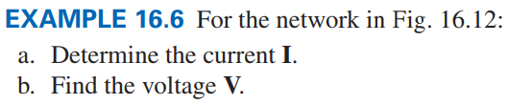
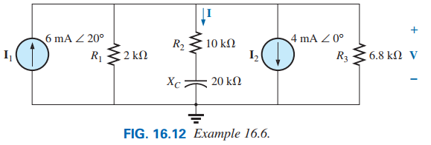
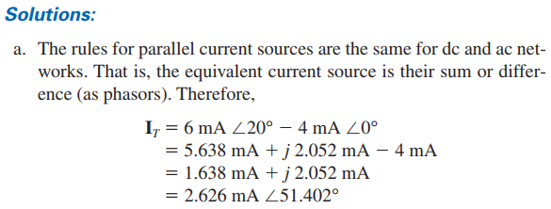
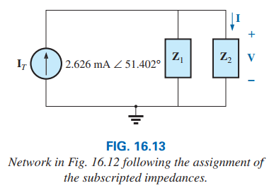
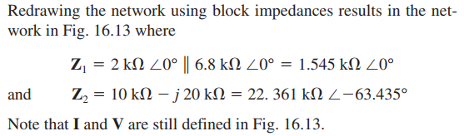
10

Slide 11
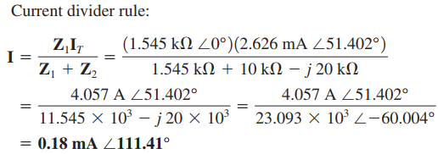

Calculate the currents I.
(b) Calculate the voltage V.
11

Slide 12
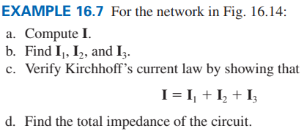
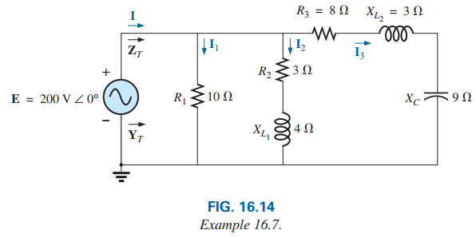
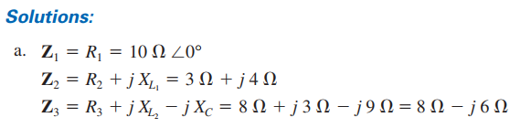
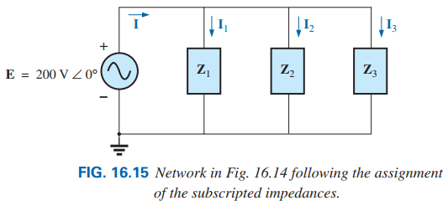
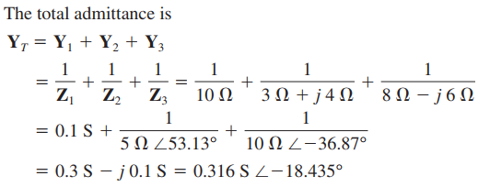
12

Slide 13

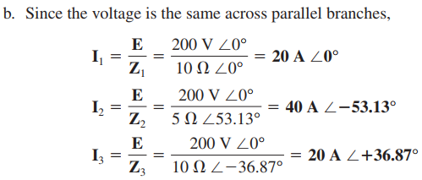
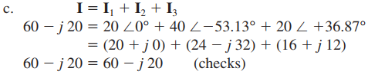

(b) Find the currents I₁, I₂ and I₃.
(c) Verify KCL:
(d) Find the total impedance of the circuit.
13

Slide 14
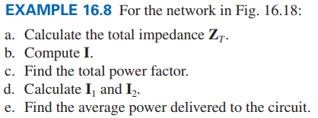
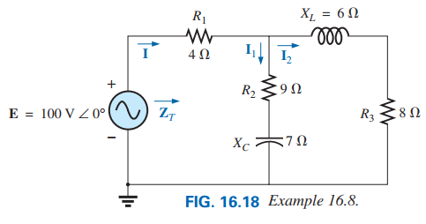
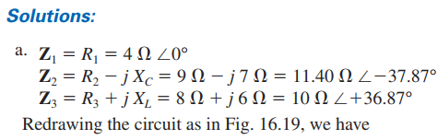
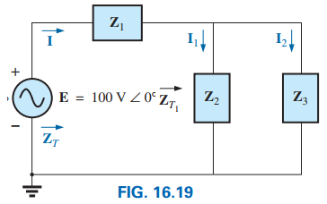
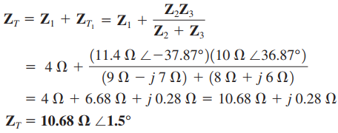
14

Slide 15


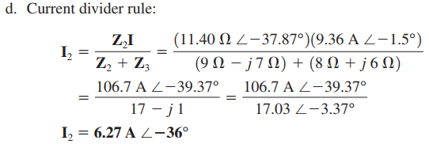
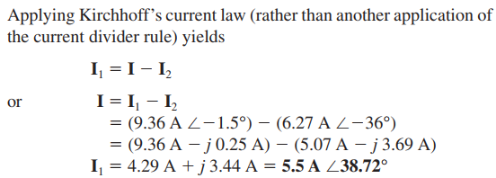
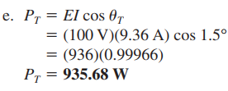
15

Slide 16
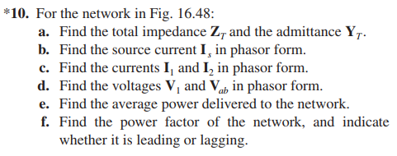
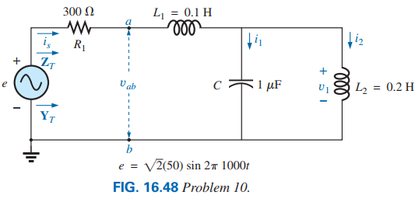
Solution: Here, E = 50 V, f =1000 Hz and ω =2π×1000 =6280 rad/s
$$E=50V0°$$
$$Let, Z_{1}=300 =3000°$$
$$X_{L1}=ωL_{1}=(6280 rad/s)(0.1 H) =628 $$
$$Z_{2}=j628 =62890°$$
$$X_{C}= \frac{1}{ωC}=\frac{1}{(6280 rad/s)(1×{10}^{−6} F)}=159.24 $$
$$Z_{3}=−j159.24 =159.24−90°$$
$$X_{L2}=ωL_{2}=(6280 rad/s)(0.2 H) =1256 $$
$$Z_{4}=j1256 =125690°$$
Fig. 16.48(a) shows the redrawing circuit of Fig. 16.48.
16

Slide 17


a
a
Z₁
Z₂
Z₁
Z₂
I_{s}
I₂
I_{s}
I₁
Z_{T}
+
Z_{T}
+
+
+
V₁
V_{ab}
V₁
Z₅
V_{ab}
Z₃
Z₄
E
−
E
−
−
−
Y_{T}
Y_{T}
b
b
Fig. 16.48(a)
Fig. 16.48(b)
a
$$Z_{5}= \frac{Z_{3}Z_{4}}{Z_{3}+Z_{4}}=\frac{\left(−j159.24 Ω\right)(j1256 Ω)}{\left(−j159.24 Ω\right)+(j1256 Ω)}$$
$=−j182.36 =182.36−90°$
Z₁
I_{s}
+
Z_{T}
Fig. 16.48(b) shows the redrawing circuit of Fig. 16.48(a).
V_{ab}
Z₆
E
$$Z_{6}=Z_{2}+Z_{5}=j445.64 =445.6490°$$
−
Y_{T}
Fig. 16.48(c) shows the redrawing circuit of Fig. 16.48(b).
b
Fig. 16.48(c)
$$Z_{T}=Z_{1}+Z_{6}=300+j445.64 =537.2156.05°$$
17

Slide 18
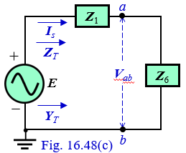
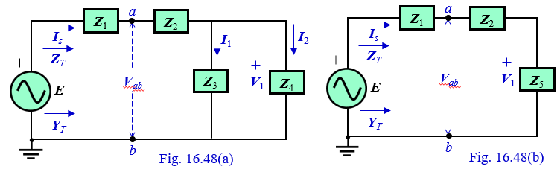
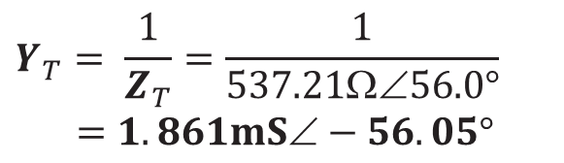
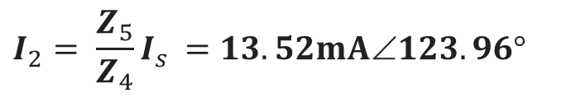
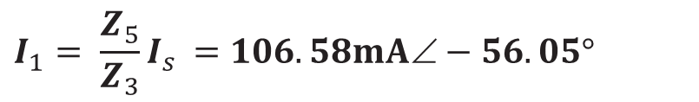
Fig. 16.48(d) shows the redrawing circuit of Fig. 16.48(c).
(d) Referring to Fig. 16.48(b) and Fig. 16.48(c), V_{ab} and V₁ are:
I_{s}
$$Y_{T}= \frac{1}{Z_{T}}=\frac{1}{537.21Ω∠56.0°}$$
$=1.861mS−56.05°$
$$V_{ab}=Z_{6}I_{s }=41.48V33.95°$$
+
Z_{T}
$$V_{1}=Z_{5}I_{s }=16.98V213.95°$$
E
Z_{T}
−
(e) Average power:
Y_{T}
$$P=EI_{s }cosθ_{T}$$
$=50×\left(93.07mA\right)cos\left(56.05°\right)$ $=2.6 W$
Fig. 16.48(d)
$$\left(b\right) I_{s}= \frac{E}{Z_{T}}=\frac{50V∠0°}{537.21Ω∠56.05°}=93.07mA∠−56.05°$$
(f) Power Factor:
$F_{p}=cosθ_{T}=0.558$Lagging
(c) Referring to Fig. 16.48(a) and Fig. 16.48(b), I₁ and I₂ are:
$$I_{1}= \frac{Z_{5}}{Z_{3}}I_{s }=106.58mA∠−56.05°$$
Practice Book Remaining Examples
And
All Problems of Chapter 16
$$I_{2}= \frac{Z_{5}}{Z_{4}}I_{s }=13.52mA∠123.96°$$
18

Slide 19
Power Factor Correction (PFC)
Or
Power Factor Improvement (PFI)
19

Slide 20
Source Side
Load Side
Transmission Line
It is observed from above equations that, low power factor of load means high apparent power. High apparent power means high current flows through the transmission line since the supply voltage E is constant. The effects of high current flow through the transmission line are as follows:
(1) Increased power losses (by a squared factor since P_{xline}=I²R_{xline}) in the transmission lines due to the resistance of the lines
(2) Required larger conductors, increasing the amount of copper needed for the system
(3) Voltage drop in Transmission line is increased as well as load terminal voltage is decreased
(4) Increased power bill
The required reactive power of load can be supplied by connecting capacitors (reactive elements) at the terminal of load. As a results high reactive power supplied by the source is not required as well as supply apparent power and current will be reduced.
The process of introducing reactive elements (capacitors) to bring the power factor closer to unity is called power-factor correction.
20

Slide 21
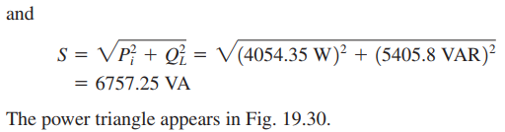



Example 19.7 A 5 hp motor with a 0.6 lagging power factor and an efficiency of 92% is connected to a 208 V, 60 Hz supply.
a. Establish the power triangle for the load.
b. Determine the power-factor capacitor that must be placed in parallel
with the load to raise the power factor to unity.
c. Determine the change in supply current from the uncompensated to
the compensated system.
21

Slide 22


Practice Book Problems [Ch. 19] 16, 17 and 18
22

Slide 23
Source Transformation

Slide 24



Source Transformation
Solution: Let,
Redrawing circuit is shown in Fig. (a). Now, the series combination of voltage source and Z₁ resistance convert to parallel circuit as follows:
EXAMPLE 16.3: Calculate V_{x} in the circuit of following figure using the method of source transformation.
24

Slide 25




Redrawing circuit is shown in Fig. (b).
Converting the current source to a voltage source yields the circuit in Fig. (d), where,
Now, by using VDR, we have:
Redrawing circuit is shown in Fig. (c).
Practice Problem
Calculate I_{o} in the circuit of following figure using the method of source transformation.
25

Slide 26
Example Related to
Open Circuit and Short Circuit

Slide 27


Example: For the following circuits, find voltage drop across the terminals a and b.
4 Ω
a
+
3 Ω
20V∠0º
b
−
3 Ω
a
4 Ω
+
120V∠90º
b
−
27

Slide 28
Example: Find the voltage drop across the terminals a and b. when the terminals are open.
10 Ω
12 Ω
a
+
120V∠0º
8 Ω
9 Ω
−
b
Due to the open circuit no current flows through the 12 Ω capacitive reactance, so the voltage drop across the a and b terminals is equal to the voltage drop across the 8 Ω inductive reactance.
Solution: Redraw the circuit by considering a and b terminals are open
I_{ab} = 0 A
a
10 Ω
12 Ω
a
+
120V∠0º
8 Ω
−
b
b
28

Slide 29
Example: Find the current passing through the terminals a and b. when the terminals are shorted.
10 Ω
12 Ω
a
+
120V∠0º
8 Ω
9 Ω
−
b
Solution: (a) Redraw the circuit by considering a and b terminals are open
10 Ω
12 Ω
a
+
120V∠0º
8 Ω
I_{ab}
−
b
29

Slide 30
Example: Find the voltage drop across the terminals a and b. when the terminals are open.
10 Ω
a
+
120V∠0º
8 Ω
8 Ω
−
b
Solution: Redraw the circuit by considering a and b terminals are open
10 Ω
+
a
+
V_{ab}
120V∠0º
−
8 Ω
b
−
30

Slide 31
Example: Find the current passing through the terminals a and b. when the terminals are shorted.
10 Ω
a
+
Due to the short circuit no current flows through the 8 Ω capacitive reactance, so the current passes through the a and b terminals can be calculated as:
120V∠0º
8 Ω
8 Ω
−
b
Solution: (a) Redraw the circuit by considering a and b terminals are open
10 Ω
a
I₈ = 0 A
+
120V∠0º
I_{ab}
8 Ω
−
b
31

